Slide 1
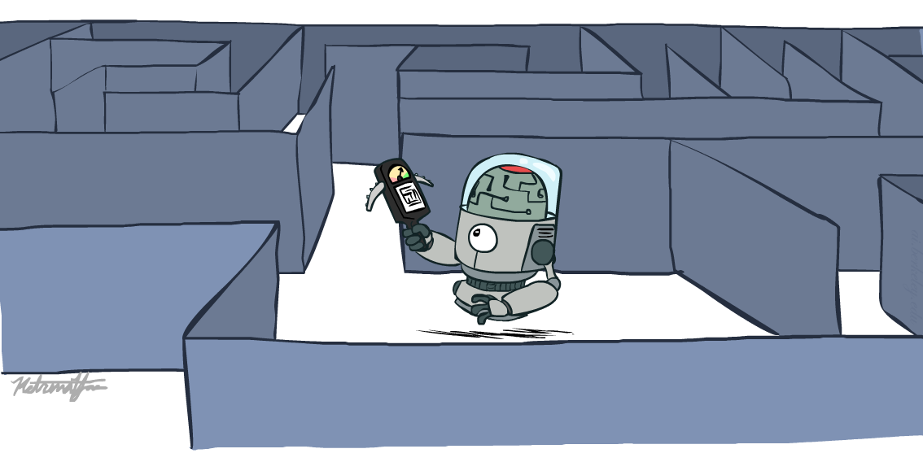
Artificial Intelligence
Informed Search
Notes:
Please retain proper attribution, including the reference to ai.berkeley.edu. Thanks!
<number>

Slide 2
AI searching Strategies
Searching Strategies in AI
Un-informed
(Blind Search)
Informed
(Heuristic Search)
Un-informed
(Blind Search)
Un-informed
(Blind Search)
Depth-first (DFS)
Breadth-First
(BFS)
Best-First
(BFS)
Hill
Climbing
Constraint Satisfaction
Depth-first (DFS)
Cost-First
(CFS)
Depth-
Limited
(DLS)
A* Search
Iterative
Deepening
(IDS)
A very large number of AI problems are formulated as search problems.
Notes:
<number>

Slide 3

Today
Informed Search
Heuristics
Greedy Search
A* Search
Graph Search
Notes:
<number>

Slide 4

Recap: Search
s₀ ← sense/read initial state
GOAL? ← select/read goal test
Succ ← read successor function
solution ← search(Space, s₀, GOAL?)
perform(solution)
Notes:
<number>

Slide 5
Recap: Search
Search tree:
Nodes: represent plans for reaching states
Plans have costs (sum of action costs)
Search algorithm:
Systematically builds a search tree
Chooses an ordering of the fringe (unexplored nodes)
Optimal: finds least-cost plans
Notes:
<number>

Slide 6
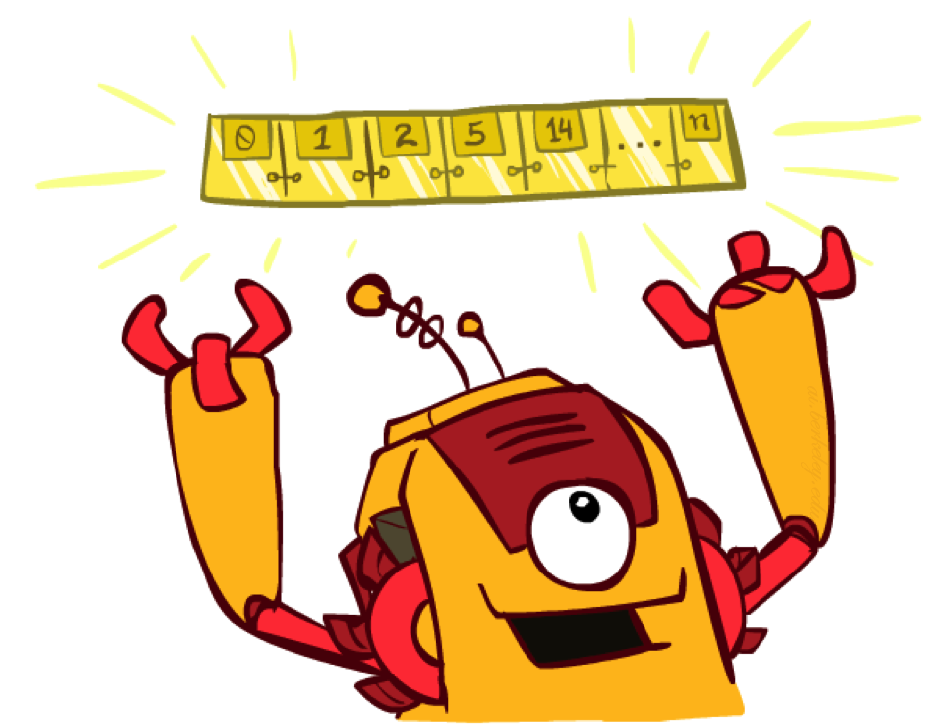
The One Queue
All these search algorithms are the same except for fringe strategies
Conceptually, all fringes are priority queues (i.e. collections of nodes with attached priorities)
Practically, for DFS and BFS, you can avoid the log(n) overhead from an actual priority queue, by using stacks and queues
Can even code one implementation that takes a variable queuing object
Notes:
<number>

Slide 7

Uninformed Search
Notes:
<number>

Slide 8
Uniform Cost Search
Strategy: expand lowest path cost
The good: UCS is complete and optimal!
The bad:
Explores options in every “direction”
No information about goal location
c ≤ 1
…
c ≤ 2
c ≤ 3
Start
Goal
Notes:
<number>

Slide 9
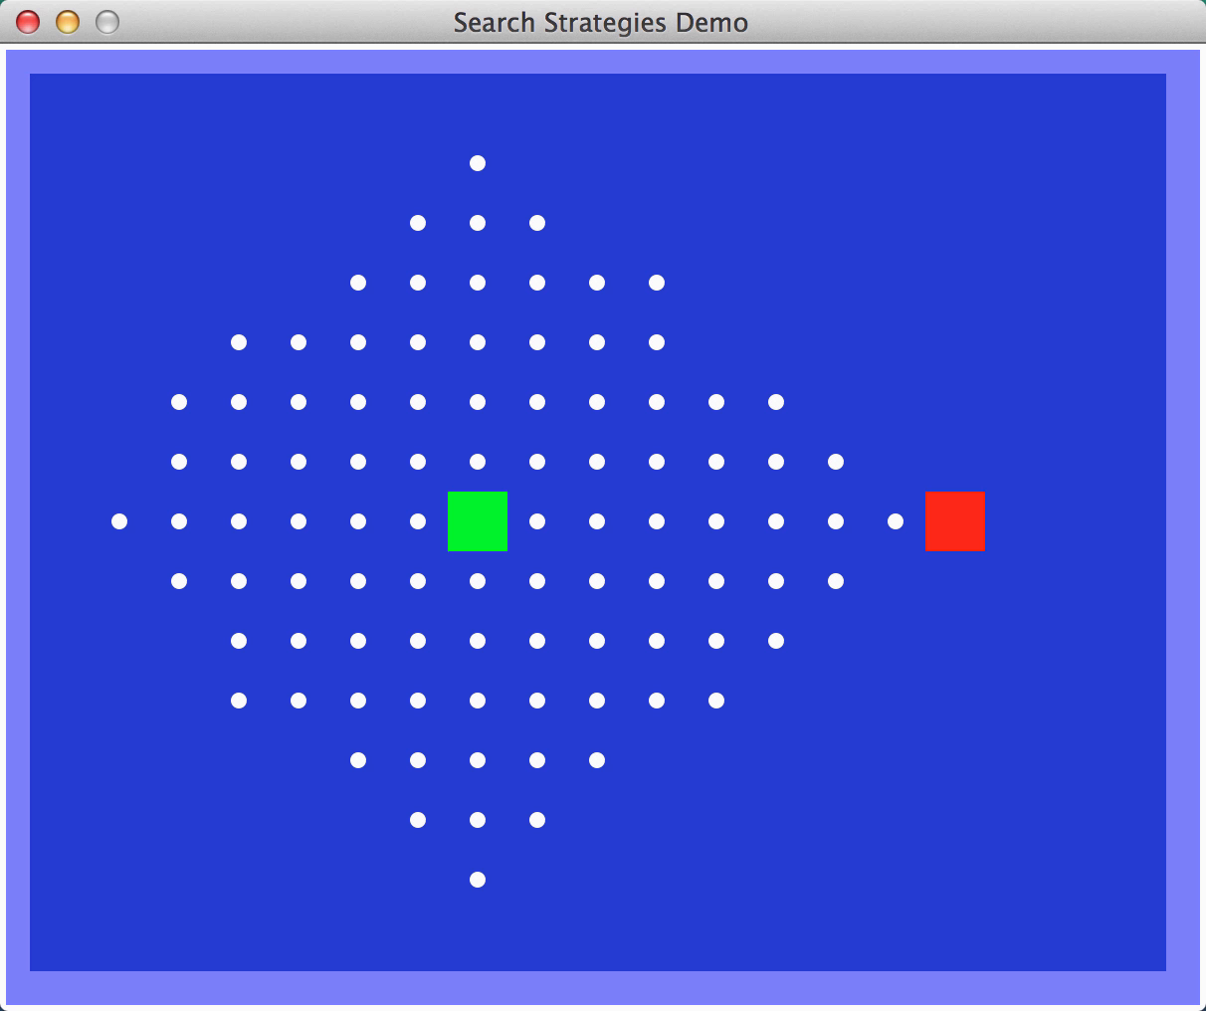
Video of Demo Contours UCS Empty
Notes:
<number>

Slide 10
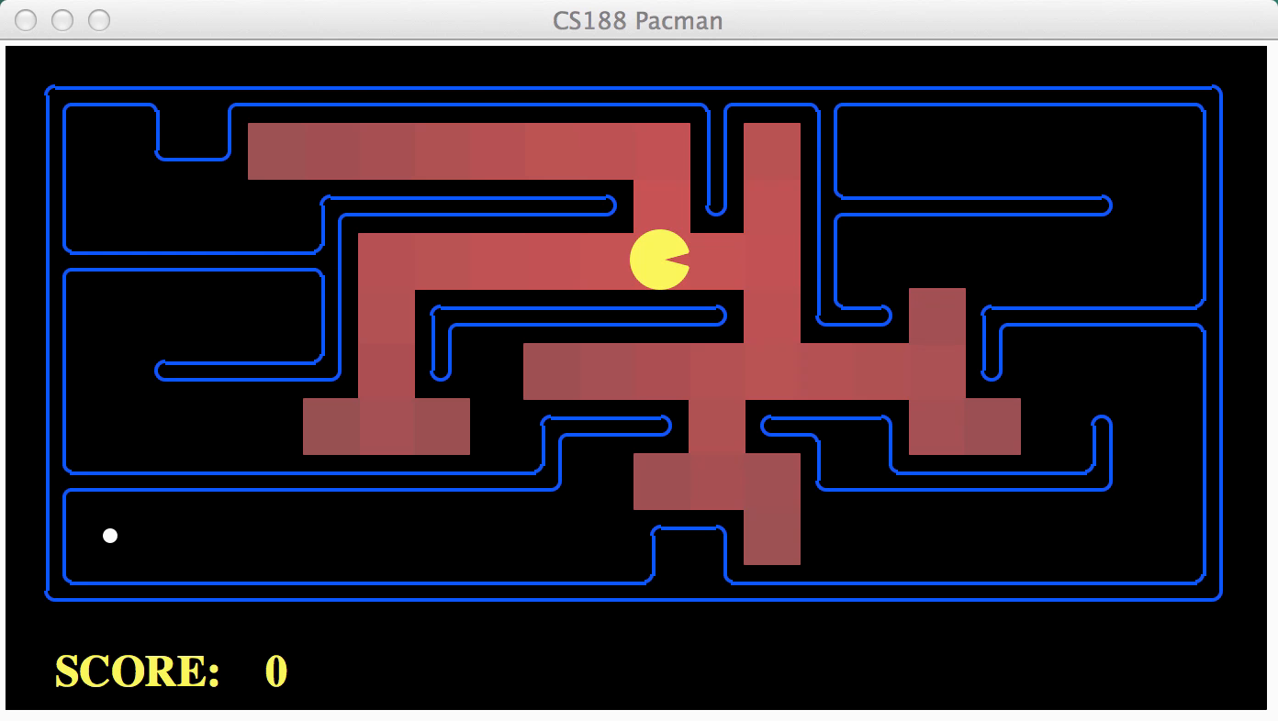
Video of Demo Contours UCS Pacman Small Maze
Notes:
<number>

Slide 11

Informed Search
Notes:
<number>

Slide 12


Search Heuristics
A heuristic is:
A function that estimates how close a state is to a goal
Designed for a particular search problem
Examples: Manhattan distance, Euclidean distance for pathing
Notes:
12

Slide 13

Distance
Manhattan Distance (L₁ Norm):
Euclidean Distance (L₂ Norm):
Chebychev Distance (L∞ Norm):
10
5
11.2

Slide 14
Distance
Euclidean Distance (L₁ Norm):
Manhattan Distance (L₂ Norm):
Chebychev Distance (L∞ Norm):
10
5
11.2

Slide 15
L₁, L₂, L ∞ Examples

Slide 16
Evaluation Function
It exploits state description to estimate how “good” each search node is
An evaluation function f maps each node N of the search tree to a real number f(N) ≥ 0 [Traditionally, f(N) is an estimated cost; so, the smaller f(N), the more promising N]
Notes:
12

Slide 17
How to construct f?
Typically, f(N) estimates:
either the cost of a path from N to a goal
Then f(N) = h(N) → Greedy best-search
or the cost of a solution path through N
Then f(N) = g(N) + h(N), where → A-Star Saarch
g(N) is the cost of the path from the initial node to N
h(N) is an estimate of the cost of a path from N to a goal node
But there are no limitations on f. Any function of your choice is acceptable. But will it help the search algorithm?
Notes:
12

Slide 18

Greedy Search
Notes:
12

Slide 19
Best-First Search
An evaluation function f maps each node N of the search tree to a real number
f(N) = h(N) ≥ 0
Best-first search sorts the FRINGE in increasing f [Arbitrary order is assumed among nodes with equal f]
Notes:
12

Slide 20
Example: Heuristic Function
h(x)
Notes:
12

Slide 21
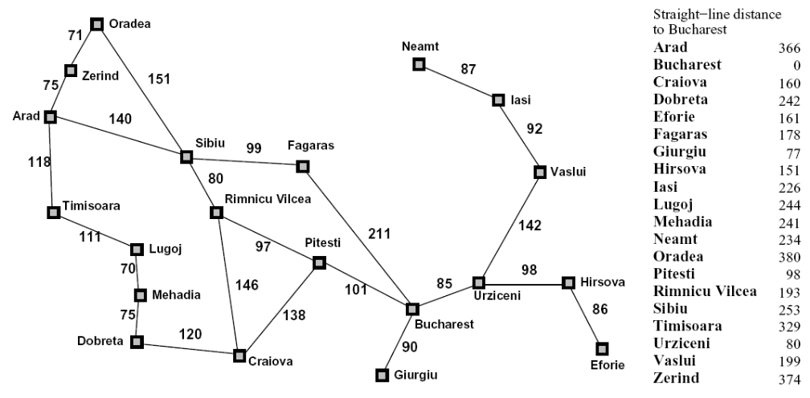
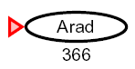

Greedy Search
Expand the node that seems closest…
Notes:
12

Slide 22
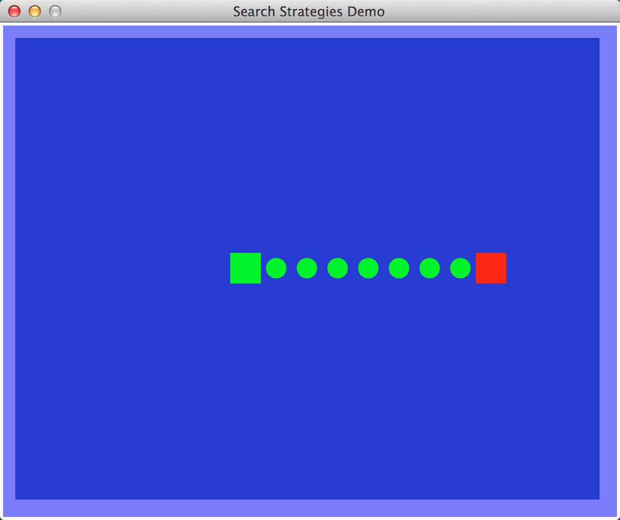
Video of Demo Contours Greedy (Empty)
Notes:
12

Slide 23
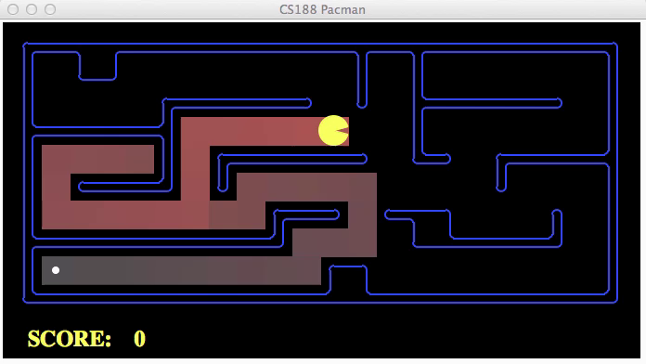
Video of Demo Contours Greedy (Pacman Small Maze)
Notes:
12

Slide 24
Greedy Search
b
Strategy: expand a node that you think is closest to a goal state
Heuristic: estimate of distance to nearest goal for each state
A common case:
Best-first takes you straight to the (wrong) goal
…
b
…
Notes:
12

Slide 25
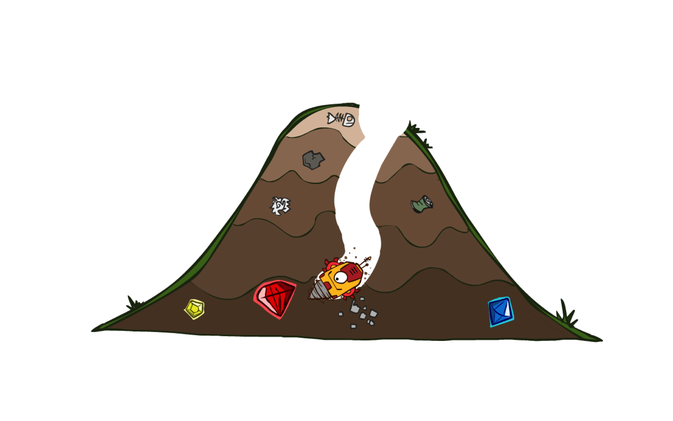
A* Search
Notes:
12

Slide 26
A* Search (most popular algorithm in AI)
f(N) = g(N) + h(N), where:
g(N) = cost of best path found so far to N
h(N) = admissible heuristic function
for all arcs: c(N,N’) ≥ ε > 0
➔ Best-first search is then called A* search
Notes:
12

Slide 27

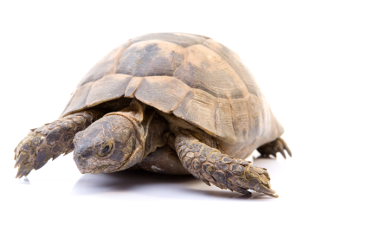

A* Search
UCS
Greedy
A*
Notes:
Notes: these images licensed from iStockphoto for UC Berkeley use.
12

Slide 28
Combining UCS and Greedy
Uniform-cost orders by path cost, or backward cost g(n)
8
g = 0
S
e
g = 1
a
1
1
3
2
g = 2
g = 9
S
a
d
G
b
d
g = 4
e
1
1
g = 3
g = 6
g = 10
c
b
c
G
d
g = 12
G
Notes:
12

Slide 29
Combining UCS and Greedy
Greedy orders by goal proximity, or forward cost h(n)
8
h=6
S
e
h=1
h=5
a
1
1
3
2
h=6
h=1
S
a
d
G
b
d
h=2
e
h=6
1
h=5
h=2
h=0
1
h=7
h=0
h=2
c
b
c
G
d
h=7
h=6
h=0
G
Notes:
12

Slide 30
Combining UCS and Greedy
Uniform-cost orders by path cost, or backward cost g(n)
Greedy orders by goal proximity, or forward cost h(n)
A* Search
8
g = 0 h=6
S
e
h=1
g = 1 h=5
a
1
1
3
2
g = 2 h=6
g = 9 h=1
S
a
d
G
b
d
g = 4 h=2
e
h=6
1
h=5
h=2
h=0
1
g = 3 h=7
g = 6 h=0
g = 10 h=2
c
b
c
G
d
h=7
h=6
g = 12 h=0
G
Notes:
12

Slide 31
When should A* terminate?
Should we stop when we enqueue a goal?
No: only stop when we dequeue
h = 2
A
2
2
S
h = 3
h = 0
G
2
B
3
h = 1
Notes:
12

Slide 32
A* Graph Search Gone Wrong?
State space graph
Search tree
A
S (0+2)
1
S
1
C
h=4
h=1
A (1+4)
B (1+1)
h=2
1
2
B
3
C (2+1)
C (3+1)
h=1
G
G (5+0)
G (6+0)
h=0
Notes:
12

Slide 33
Is A* Optimal?
h = 6
1
A
3
S
h = 7
G
h = 0
5
What went wrong?
Actual bad goal cost < estimated good goal cost
Notes:
12

Slide 34
Heuristic Function
The heuristic function h(N) ≥ 0 estimates the cost to go from STATE(N) to a goal state Its value is independent of the current search tree; it depends only on STATE(N) and the goal test GOAL?
Example:
h₁(N) = number of misplaced numbered tiles = 6
[Why is it an estimate of the distance to the goal?]
5
8
1
2
3
4
2
1
4
5
6
7
3
6
7
8
STATE(N)
Goal state
Notes:
12

Slide 35
Other Examples
h₁(N) = number of misplaced numbered tiles = 6
h₂(N) = sum of the (Manhattan) distance of every numbered tile to its goal position = 2 + 3 + 0 + 1 + 3 + 0 + 3 + 1 = 13
h₃(N) = sum of permutation inversions = n₅ + n₈ + n₄ + n₂ + n₁ + n₇ + n₃ + n₆ = 4 + 6 + 3 + 1 + 0 + 2 + 0 + 0 = 16
5
8
1
2
3
4
2
1
4
5
6
7
3
6
7
8
STATE(N)
Goal state
Notes:
12

Slide 36
8-Puzzle
f(N) = h(N) = number of misplaced numbered tiles
3
3
4
5
3
4
2
4
2
1
3
3
0
4
5
4
The white tile is the empty tile
Notes:
12

Slide 37
8-Puzzle
f(N) = h(N) = Σ distances of numbered tiles to their goals
6
5
2
5
2
1
4
3
0
4
6
5
Notes:
12

Slide 38
8-Puzzle
f(N) = g(N) + h(N) with h(N) = number of misplaced numbered tiles
3+3
1+5
2+3
3+4
5+2
0+4
3+2
4+1
1+3
2+3
5+0
3+4
1+5
2+4
Notes:
12

Slide 39
Admissible Heuristic
Let h*(N) be the cost of the optimal path from N to a goal node
The heuristic function h(N) is admissible if: 0 ≤ h(N) ≤ h*(N)
An admissible heuristic function is always optimistic !
G is a goal node ➔ h(G) = 0
Notes:
12

Slide 40
8-Puzzle Heuristics
h1(N) = number of misplaced tiles = 6
is admissible
h2(N) = sum of the (Manhattan) distances of every tile to its goal position = 2 + 3 + 0 + 1 + 3 + 0 + 3 + 1 = 13
is admissible
5
8
1
2
3
4
2
1
4
5
6
7
3
6
7
8
STATE(N)
Goal state
Notes:
12

Slide 41
Robot Navigation
y_{N}
N
y_{g}
x_{N}
x_{g}
(L₂ or Euclidean distance)
h₂(N) = |x_{N}-x_{g}| + |y_{N}-y_{g}|
(L₁ or Manhattan distance)
Notes:
12

Slide 42
Robot Navigation Heuristics
Cost of one horizontal/vertical step = 1
Cost of one diagonal step =
is admissible
Notes:
12

Slide 43
Robot Navigation Heuristics
Cost of one horizontal/vertical step = 1
Cost of one diagonal step =
h₂(N) = |x_{N}-x_{g}| + |y_{N}-y_{g}|
is ???
Notes:
12

Slide 44
Robot Navigation Heuristics
Cost of one horizontal/vertical step = 1
Cost of one diagonal step =
h₂(N) = |x_{N}-x_{g}| + |y_{N}-y_{g}|
is admissible if moving along
diagonals is not allowed, and
not admissible otherwise
h*(I) = 4√2
h₂(I) = 8
Notes:
12

Slide 45
Robot Navigation
Notes:
12

Slide 46
Robot Navigation
f(N) = h(N), with h(N) = Manhattan distance to the goal (not A*)
8
7
6
5
4
3
2
3
4
5
6
7
5
4
3
5
6
3
2
1
0
1
2
4
7
6
5
8
7
6
5
4
3
2
3
4
5
6
Notes:
12

Slide 47
Robot Navigation
f(N) = h(N), with h(N) = Manhattan distance to the goal
(not A*)
8
7
6
5
4
3
2
3
4
5
6
7
5
4
3
5
6
3
2
1
0
0
1
2
4
7
7
6
5
8
7
6
5
4
3
2
3
4
5
6
Notes:
12

Slide 48
Robot Navigation
f(N) = g(N)+h(N), with h(N) = Manhattan distance to goal
(A*)
8+3
8+3
7+4
7+4
6+5
6+3
5+6
5+6
4+7
4+7
3+8
3+8
2+9
8
7
6
5
4
3
2+9
3+10
2
3
4
5
6
7+2
7+2
5+6
4+7
3+8
7
5
4
3+8
3
5
6+1
6+1
2+9
2+9
1+10
1+10
0+11
6
3
2
1
0+11
0
1
2
4
7+0
7+0
6+1
7
6+1
6
5
8+1
8+1
7+2
7+2
6+3
6+3
5+4
5+4
4+5
4+5
3+6
3+6
2+7
8
7
6
5
4
3
2+7
3+8
2
3
4
5
6
Notes:
12

Slide 49
How to create an admissible h?
An admissible heuristic can usually be seen as the cost of an optimal solution to a relaxed problem (one obtained by removing constraints)
In robot navigation:
The Manhattan distance corresponds to removing the obstacles
The Euclidean distance corresponds to removing both the obstacles and the constraint that the robot moves on a grid
More on this topic later
Notes:
12

Slide 50

Admissible Heuristics
Notes:
12

Slide 51

Idea: Admissibility
Inadmissible (pessimistic) heuristics break optimality by trapping good plans on the fringe
Admissible (optimistic) heuristics slow down bad plans but never outweigh true costs
Notes:
12

Slide 52


Admissible Heuristics
A heuristic h is admissible (optimistic) if:
where is the true cost to a nearest goal
Examples:
15
Notes:
12

Slide 53

Creating Heuristics
Notes:
12

Slide 54
Creating Admissible Heuristics
Most of the work in solving hard search problems optimally is in coming up with admissible heuristics
Often, admissible heuristics are solutions to relaxed problems, where new actions are available
366
15
Notes:
12

Slide 55
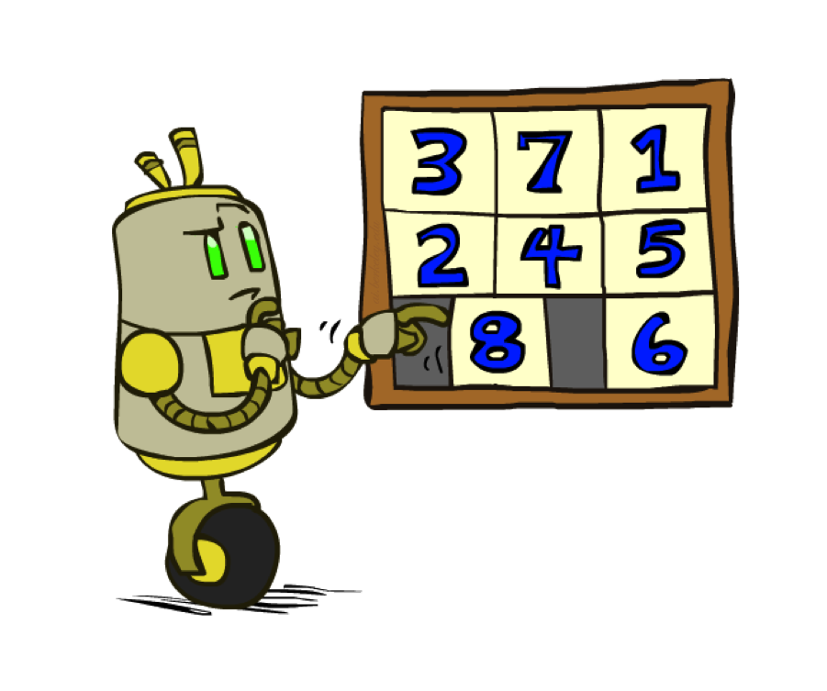
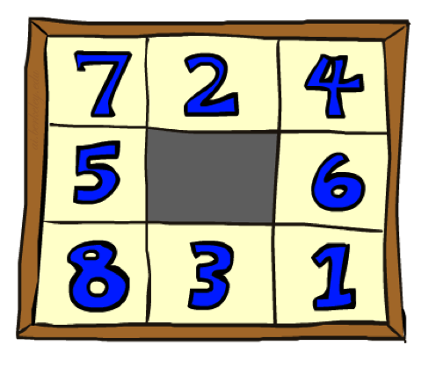
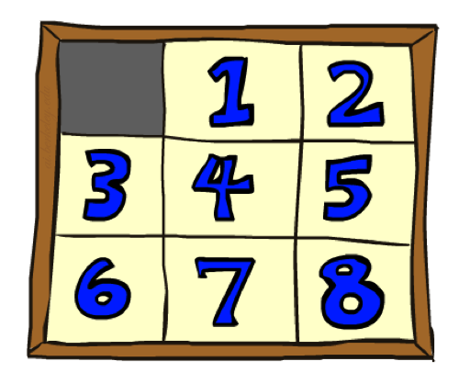
Example: 8 Puzzle
Start State
Actions
Goal State
What are the states?
How many states?
What are the actions?
How many successors from the start state?
What should the costs be?
Notes:
12

Slide 56
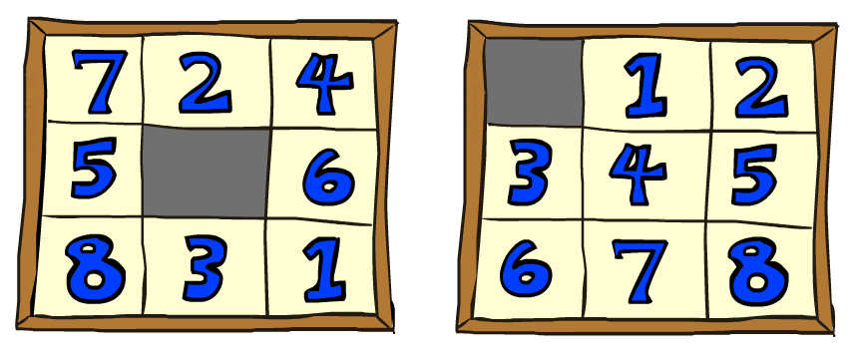
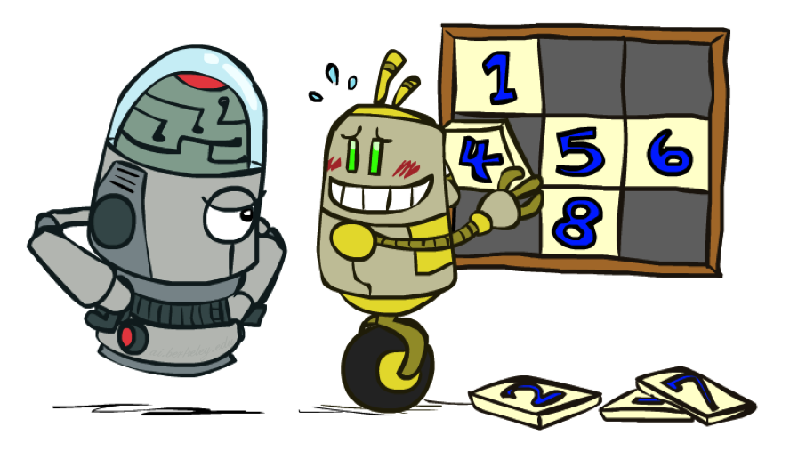
8 Puzzle I
Heuristic: Number of tiles misplaced
Why is it admissible?
h(start) =
This is a relaxed-problem
8
Start State
Goal State
 | Average nodes expanded when the optimal path has…
 | …4 steps | …8 steps | …12 steps
UCS | 112 | 6,300 | 3.6 x 10⁶
TILES | 13 | 39 | 227
Statistics from Andrew Moore
Notes:
12

Slide 57
8 Puzzle II
What if we had an easier 8-puzzle where any tile could slide any direction at any time, ignoring other tiles?
Total Manhattan distance
Why is it admissible?
h(start) =
Start State
Goal State
 | Average nodes expanded when the optimal path has…
 | …4 steps | …8 steps | …12 steps
TILES | 13 | 39 | 227
MANHATTAN | 12 | 25 | 73
3 + 1 + 2 + … = 18
Notes:
12

Slide 58
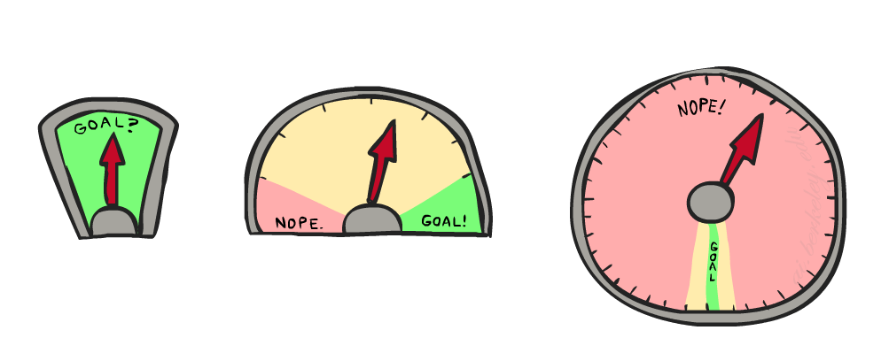
8 Puzzle III
How about using the actual cost as a heuristic?
Would it be admissible?
Would we save on nodes expanded?
What’s wrong with it?
With A*: a trade-off between quality of estimate and work per node
Notes:
12

Slide 59
Consistency of Heuristics
Main idea: estimated heuristic costs ≤ actual costs
Admissibility: heuristic cost ≤ actual cost to goal
h(A) ≤ actual cost from A to G
Consistency: heuristic “arc” cost ≤ actual cost for each arc
h(A) – h(C) ≤ cost(A to C)
Consequences of consistency:
The f value along a path never decreases
h(A) ≤ cost(A to C) + h(C)
A* graph search is optimal
A
1
C
h=4
h=1
h=2
3
G
Notes:
12

Slide 60

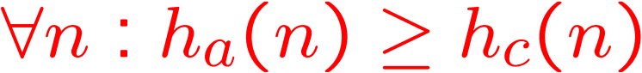
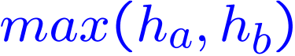
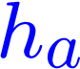
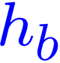
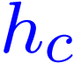

Trivial Heuristics, Dominance
Dominance: h_{a} ≥ h_{c} if
Heuristics form a semi-lattice:
Max of admissible heuristics is admissible
Trivial heuristics
Bottom of lattice is the zero heuristic (what does this give us?)
Top of lattice is the exact heuristic
Notes:
12

Slide 61

Optimality of A* Tree Search
Notes:
12

Slide 62


Optimality of A* Tree Search
Assume:
A is an optimal goal node
B is a suboptimal goal node
h is admissible
Claim:
A will exit the fringe before B
…
Notes:
12

Slide 63


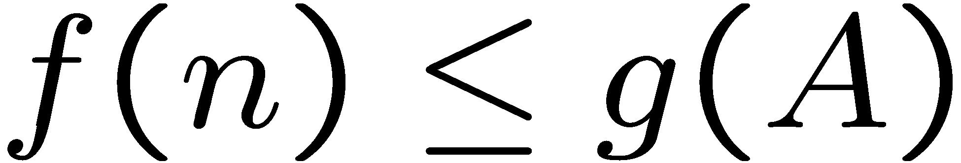
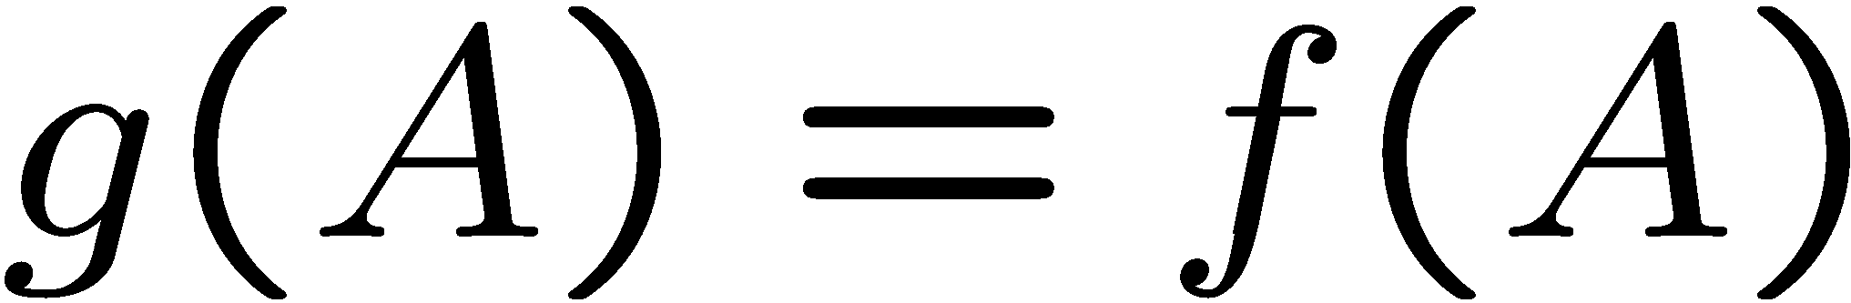
Optimality of A* Tree Search: Blocking
Proof:
Imagine B is on the fringe
Some ancestor n of A is on the fringe, too (maybe A!)
Claim: n will be expanded before B
…
Definition of f-cost
Admissibility of h
h = 0 at a goal
Notes:
12

Slide 64


Optimality of A* Tree Search: Blocking
Proof:
Imagine B is on the fringe
Some ancestor n of A is on the fringe, too (maybe A!)
Claim: n will be expanded before B
f(n) is less or equal to f(A)
…
B is suboptimal
h = 0 at a goal
Notes:
12

Slide 65

Optimality of A* Tree Search: Blocking
Proof:
Imagine B is on the fringe
Some ancestor n of A is on the fringe, too (maybe A!)
Claim: n will be expanded before B
f(n) is less or equal to f(A)
f(A) is less than f(B)
n expands before B
All ancestors of A expand before B
A expands before B
…
Notes:
12

Slide 66
Optimality of A* Graph Search
Notes:
12

Slide 67
Optimality of A* Graph Search
Sketch: consider what A* does with a consistent heuristic:
Fact 1: In tree search, A* expands nodes in increasing total f value (f-contours)
Fact 2: For every state s, nodes that reach s optimally are expanded before nodes that reach s suboptimally
Result: A* graph search is optimal
…
f ≤ 1
f ≤ 2
f ≤ 3
Notes:
12

Slide 68
Optimality
Tree search:
A* is optimal if heuristic is admissible
UCS is a special case (h = 0)
Graph search:
A* optimal if heuristic is consistent
UCS optimal (h = 0 is consistent)
Consistency implies admissibility
In general, most natural admissible heuristics tend to be consistent, especially if from relaxed problems
Notes:
12

Slide 69
Optimality of A* Graph Search
Consider what A* does:
Expands nodes in increasing total f value (f-contours) Reminder: f(n) = g(n) + h(n) = cost to n + heuristic
Proof idea: the optimal goal(s) have the lowest f value, so it must get expanded first
…
f ≤ 1
There’s a problem with this argument. What are we assuming is true?
f ≤ 2
f ≤ 3
Notes:
12

Slide 70

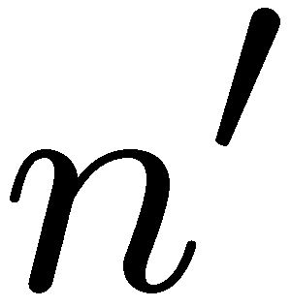
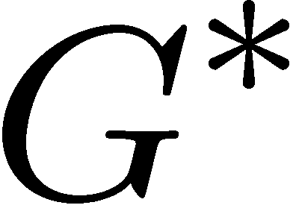

Optimality of A* Graph Search
Proof:
New possible problem: some n on path to G* isn’t in queue when we need it, because some worse n’ for the same state dequeued and expanded first (disaster!)
Take the highest such n in tree
Let p be the ancestor of n that was on the queue when n’ was popped
f(p) < f(n) because of consistency
f(n) < f(n’) because n’ is suboptimal
p would have been expanded before n’
Contradiction!
Notes:
12

Slide 71
Properties of A*
Notes:
12

Slide 72
Properties of A*
Uniform-Cost
A*
b
b
…
…
Notes:
12

Slide 73
UCS vs A* Contours
Uniform-cost expands equally in all “directions”
A* expands mainly toward the goal, but does hedge its bets to ensure optimality
Start
Goal
Start
Goal
Notes:
12

Slide 74
Video of Demo Contours (Empty) -- UCS
Notes:
12

Slide 75
Video of Demo Contours (Empty) -- Greedy
Notes:
12

Slide 76
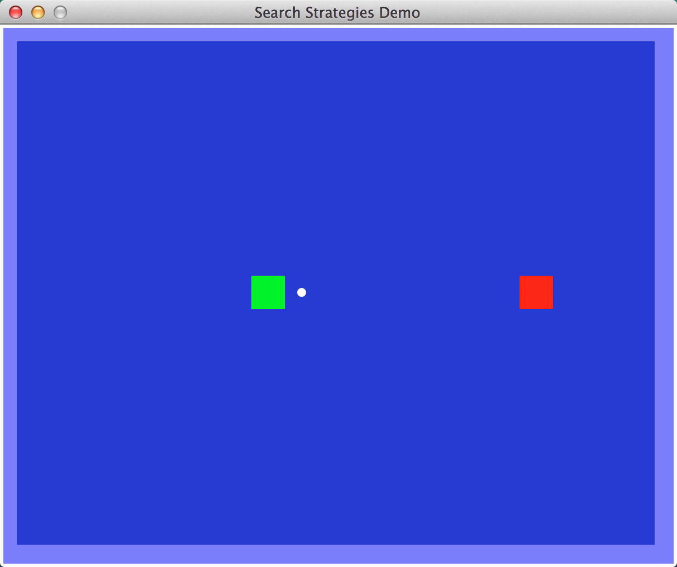
Video of Demo Contours (Empty) – A*
Notes:
12

Slide 77
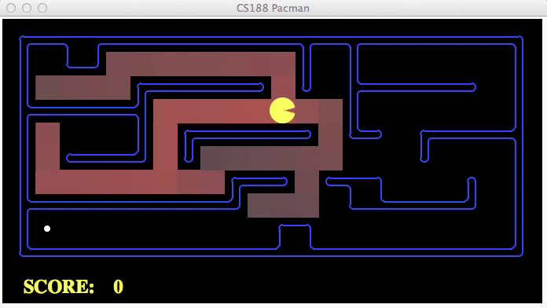
Video of Demo Contours (Pacman Small Maze) – A*
Notes:
12

Slide 78



Comparison
Greedy
Uniform Cost
A*
Notes:
12

Slide 79
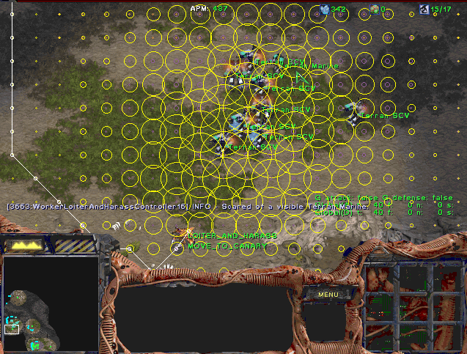
A* Applications
Notes:
12

Slide 80
A* Applications
Video games
Pathing / routing problems
Resource planning problems
Robot motion planning
Language analysis
…
Notes:
12

Slide 81
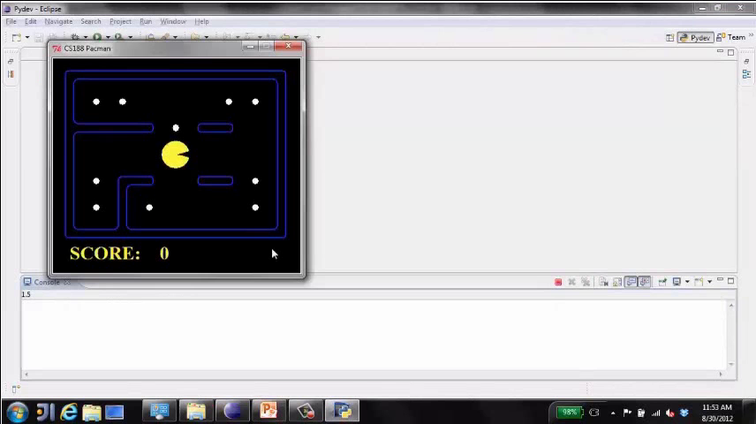
Video of Demo Pacman (Tiny Maze) – UCS / A*
Notes:
12

Slide 82
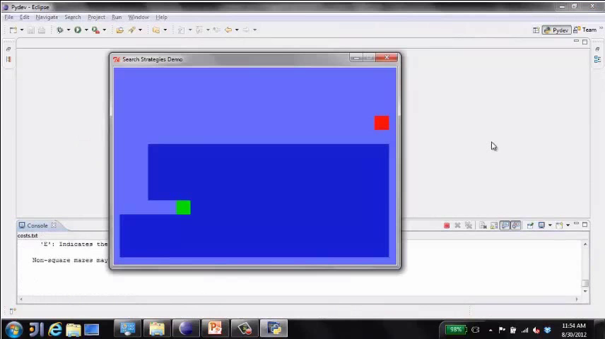
Video of Demo Empty Water Shallow/Deep – Guess Algorithm
Notes:
12

Slide 83
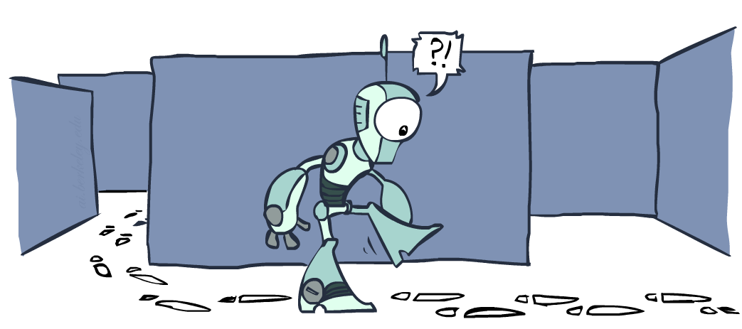
Graph Search
Notes:
12

Slide 84
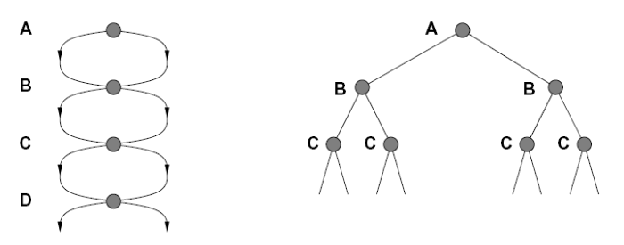
Tree Search: Extra Work!
Failure to detect repeated states can cause exponentially more work.
State Graph
Search Tree
Notes:
12

Slide 85
Graph Search
In BFS, for example, we shouldn’t bother expanding the circled nodes (why?)
S
d
e
p
b
c
e
h
r
q
a
a
h
r
p
q
f
p
q
f
q
c
G
q
c
G
a
a
Notes:
12

Slide 86
Graph Search
Idea: never expand a state twice
How to implement:
Tree search + set of expanded states (“closed set”)
Expand the search tree node-by-node, but…
Before expanding a node, check to make sure its state has never been expanded before
If not new, skip it, if new add to closed set
Important: store the closed set as a set, not a list
Can graph search wreck completeness? Why/why not?
Notes:
12

Slide 87
Iterative Deepening A* (IDA*)
Idea: Reduce memory requirement of A* by applying cutoff on values of f
Consistent heuristic function h
Algorithm IDA*:
Initialize cutoff to f(initial-node)
Repeat:
Perform depth-first search by expanding all nodes N such that f(N) ≤ cutoff
Reset cutoff to smallest value f of non-expanded (leaf) nodes
Notes:
12

Slide 88
8-Puzzle
f(N) = g(N) + h(N)
with h(N) = number of misplaced tiles
4
Cutoff=4
6
Notes:
12

Slide 89
8-Puzzle
f(N) = g(N) + h(N)
with h(N) = number of misplaced tiles
4
Cutoff=4
4
6
6
Notes:
12

Slide 90
8-Puzzle
f(N) = g(N) + h(N)
with h(N) = number of misplaced tiles
4
Cutoff=4
4
5
6
6
Notes:
12

Slide 91
8-Puzzle
f(N) = g(N) + h(N)
with h(N) = number of misplaced tiles
5
4
Cutoff=4
4
5
6
6
Notes:
12

Slide 92
8-Puzzle
f(N) = g(N) + h(N)
with h(N) = number of misplaced tiles
6
5
4
Cutoff=4
4
5
6
6
Notes:
12

Slide 93
8-Puzzle
f(N) = g(N) + h(N)
with h(N) = number of misplaced tiles
4
Cutoff=5
6
Notes:
12

Slide 94
8-Puzzle
f(N) = g(N) + h(N)
with h(N) = number of misplaced tiles
4
Cutoff=5
4
6
6
Notes:
12

Slide 95
8-Puzzle
f(N) = g(N) + h(N)
with h(N) = number of misplaced tiles
4
Cutoff=5
4
5
6
6
Notes:
12

Slide 96
8-Puzzle
f(N) = g(N) + h(N)
with h(N) = number of misplaced tiles
4
Cutoff=5
4
5
7
6
6
Notes:
12

Slide 97
8-Puzzle
f(N) = g(N) + h(N)
with h(N) = number of misplaced tiles
4
5
Cutoff=5
4
5
7
6
6
Notes:
12

Slide 98
8-Puzzle
f(N) = g(N) + h(N)
with h(N) = number of misplaced tiles
4
5
5
Cutoff=5
4
5
7
6
6
Notes:
12

Slide 99
8-Puzzle
f(N) = g(N) + h(N)
with h(N) = number of misplaced tiles
4
5
5
Cutoff=5
4
5
5
7
6
6
Notes:
12

Slide 100
Advantages/Drawbacks of IDA*
Advantages:
Still complete and optimal
Requires less memory than A*
Avoid the overhead to sort the fringe
Drawbacks:
Can’t avoid revisiting states not on the current path
Available memory is poorly used (→ memory-bounded search, see R&N p. 101-104)
Notes:
12

Slide 101
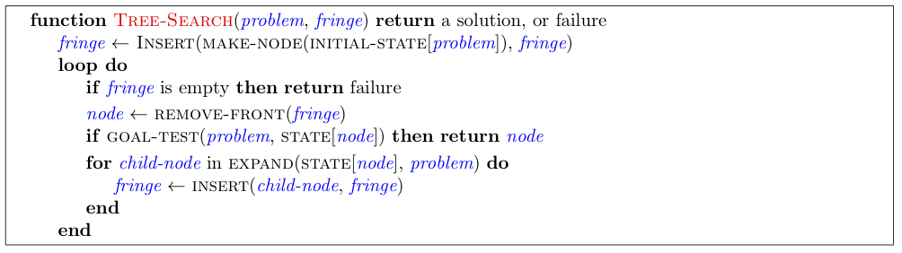
Tree Search Pseudo-Code
Notes:
12

Slide 102
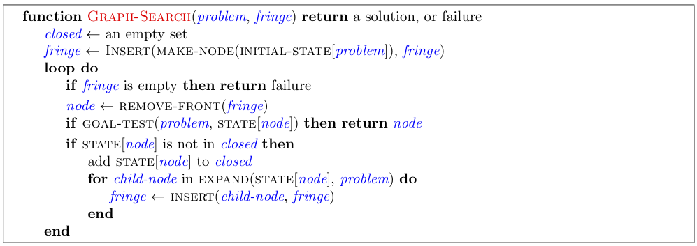
Graph Search Pseudo-Code
Notes:
12

Slide 103

A*: Summary
A* uses both backward costs and (estimates of) forward costs
A* is optimal with admissible / consistent heuristics
Heuristic design is key: often use relaxed problems
Notes:
<number>

Slide 104

A*: Summary
Notes:
<number>

